Slide 1

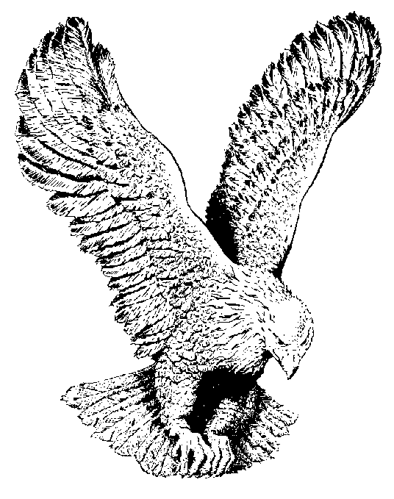
138
THE SOLID ROCK
My hope is built on nothing less
Than Jesus’ blood and righteousness;
I dare not trust the sweetest frame,
But wholly lean on Jesus’ name.

Slide 2
CHORUS
On Christ, the solid Rock, I stand;
All other ground is sinking sand,
All other ground is sinking sand.

Slide 3
When darkness seems to hide His face,
I rest on his unchanging grace;
In every high and stormy gale,
My anchor holds within the veil.

Slide 4
His oath, His covenant. His blood,
Support me in the whelming flood;
When all around my soul gives way,
He then is all my hope and stay.

Slide 5
When He shall come with trumpet sound,
Oh, may I then in Him be found;
Dressed in His righteousness alone,
Faultless to stand before the throne

